Slide 1

Windows PowerShell An Introduction
Points to Consider
Technology is now 10 years old
Widely adopted across all of Microsoft Stack
A programming language for automation at scale
Object Orientated
Simpler than VBScript
Ryan Yates - @ryanyates1990
User Group co-ordinator for PowerShell User Groups in UK

Slide 2

Who Am I?
Ryan Yates – 26 & a Microsoft Cloud & DataCentre Management MVP predominantly focused on Windows 10, PowerShell & historically SharePoint
Coordinator of Get-PSUGUK – The UK PowerShell User Groups and Co-Organiser of PSConfEU – the Premier PowerShell Conference of the year
Currently
MCP – Windows XP
Planned
TBD

Slide 3
Tweet me
@ryanyates1990
Any Photos or Questions about this now or in future

Slide 4
Professional Background
Previously
SharePoint Applications/Implementation Analyst - University Of Manchester
SharePoint User Support Services Engineering Consultant – Barclays
Various Retail Jobs
Passion for all things IT related however predominantly been Microsoft Focused since Windows XP
SharePoint was my entry into IT
However PowerShell is my Secret love
“Spend less time doing the same mundane tasks and spend more time pushing your knowledge in automation”
Simple Task Automation = Early DevOps implementation

Slide 5
Background to this Session
So perhaps you’ve heard of PowerShell?
Perhaps you’ve used it with one of Microsoft’s Server Products like SharePoint or Exchange
But if not then I expect that you have heard of the command line

Slide 6
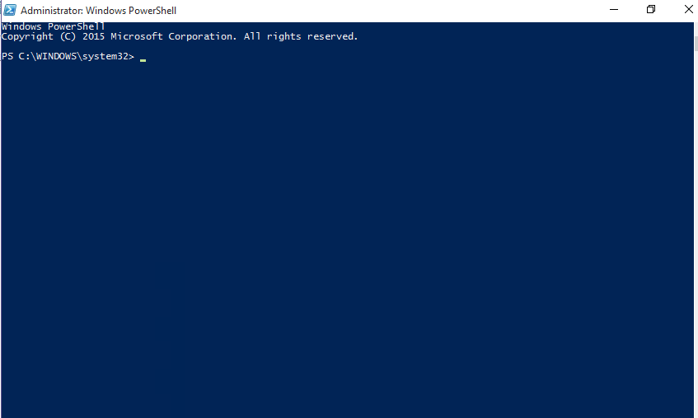
So what is PowerShell

Slide 7
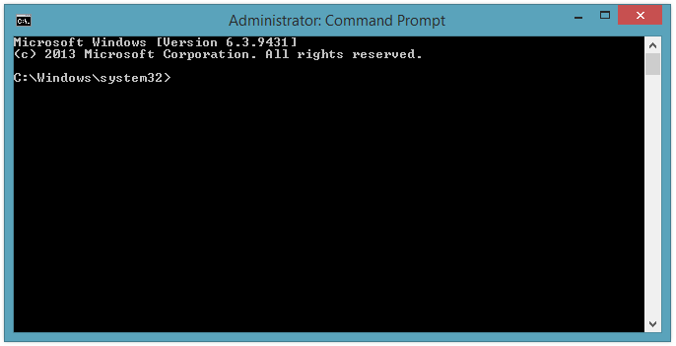
Kind of looks like this?

Slide 8
So what is the difference?
To understand this we need to cast some thoughts as to how Microsoft were looking to move to in future
Servers and Server applications were mainly configured and maintained via GUI tools – Which although great as they get the job done they aren’t scalable. This leads to issues when a company needs to expand and quickly

Slide 9
Timeline – 2002
Initially developed as Monad – or Microsoft Shell as influenced by *nix shells
First Draft of the Monad Manifesto was released internally at Microsoft by Jeffery Snover – this was a document that was able to be collaborated on and allowed a more diverse opinion centric model to which to evolve PowerShell into

Slide 10
Timeline – 2005/2006
First Public Beta released on June 17th 2005
Second public beta released September 11th 2005
Third Pubic beta released January 10th 2006
Renamed Windows Powershell on April 25th 2006 (just a month before I started my GCSE Exams) and Release Candidate 1 Released at this time as well
Release Candidate 2 released September 26th 2006
Release to Web (Powershell v1) announced at TechEd in Barcelona on November 2006

Slide 11
v1 – or was is really a v0.7?
Pros
Cmdlets used Verb-Noun naming convention
Builtin help for the Cmdlets
Could be extended with PSSnapins – Exchange & SharePoint did this
Cons
Hard to extend – PSSnapins are compiled code and you need to have development knowledge to build them
No module functionality
Basic functionality
No bundled Development environment – third party options existed
Hard to share any scripts

Slide 12
v2 – A real v1 - 2009
Pros
Module support – easier extendibility
PowerShell ISE bundled with
Part of Windows 7 & Server 2008 R2
Avail for XP, Vista, 2003 & 2008 via Microsoft Downloads
32 & 64 bit support introduced
PSRemoting and PSJobs introduced
Cons
ISE had no intellisense – so made scripting difficult
Built for .Net v2 not v4 so caused some compatibility issues going forward
Extended but still basic functionality
Best practises were not really defined
Still not understood as a Programming Language and seen like a GUI tool by most

Slide 13
v3 – A real v2 - 2009
Pros
Bundled as part of WMF 3.0
Part of Windows 8 & Server 2012
Avail for Windows 7 SP1 & 2008 R2 SP1 via Microsoft Downloads
Implicit Module Loading, Workflows, Updatable Help, ISE IntelliSense & snippets introduced
Cons
Built for .Net v4 which broke some applications like SharePoint that required v2
Best practises still not really defined but getting closer (thanks to community)
Lots of things are now easier to do because of new cmdlets – less need to rely on .Net Methods – though still able to be used.
No real module sharing method – except Technet Script Gallery

Slide 14
v4 – A real v3 - 2013
Pros
Bundled as part of WMF 4.0
Part of Windows 8.1 & Server 2012 R2
Avail for Windows 7 SP1 & 2008 R2 SP1 & 2012 via Microsoft Downloads
Where & ForEach methods, Desired State Configuration v1 & Save-Help introduced
Cons
Best practises still not really defined but getting closer (thanks to community)
DSC replaces a lot of possible custom scripts that were built to do similar tasks
Now makes it more difficult to continue write scripts with v2 Support
Although on newer OS’s and down Compat – v2 /v3 still predominant on Servers
DSC still really a v0.7 release

Slide 15
v5 – A real v4 - 2014
Pros
Bundled as part of WMF 5.0 & Windows 10 & Server 2016 TP
Avail for Windows 7 SP1 & 2008 R2 SP1 & 2012 via Microsoft Downloads
Pester, PSReadline both OS baked in, Classes, PowerShell Gallery using PSGet (again OS) DSC v2 with partial configurations
Cons
Best practises are still being defined – now on GitHub
Cons from v4 still applicable
Not fully released (Production Preview is the term being used)
Still being expanded via Windows Updates for Windows 10

Slide 16
Info Overload!!
But this is just the Tip of the Iceberg so to speak and we haven’t even really touched on the things that make PowerShell Powerful and the language to learn in 2016

Slide 17
Some of the things I use PowerShell for include
Administration for this User Group – Using Eventbrite API’s and Exchange Online Capabilities
Automatic Tweeting from list items in a SharePoint List (WIP)
Automatic Email sending to Speakers for PowerShell Conference EU
Auto Git Commit my PowerShell Scripts (because you use Source Control right?)
Auto making new Exchange Folders and Inbox rules based on GitHub Repo’s that I’m following
Auto Create Users in AD based on SharePoint List items
And many More too!

Slide 18
Any Questions??

Slide 19
Further Details
Twitter - @ryanyates1990
LinkedIn - http://uk.linkedin.com/in/ryanyates90
Blog – www.kilasuit.org/blog
Email/Lync – ryan.yates@kilasuit.org

